Slide 1
Introduction to PSY 1
Memory

Slide 2
The Cognitive Approach
As you have seen Psychology has several areas of interest.
The cognitive approach looks at perception (you were fooled in the first lesson by a gorilla)
We are going to look at memory.

Slide 3
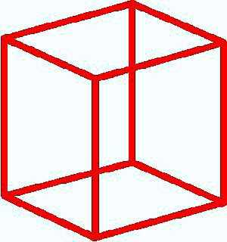
Necker Cube

Slide 4
The Cognitive Approach
Key features:
The main approach to experimental psychology
  in cognitive psychology, which investigates memory, language, perception, problem solving
  but also used for other areas, e.g. social, developmental
Emphasises active mental processes
  the brain is seen as an information processor, using the analogy of mind to computers
  mental processes are based on discrete modules
Uses experimental methods, but also computer modelling and neuropsychology

Slide 5
The Cognitive Approach
Evaluation (1):
Has had a significant impact across experimental psychology
Has led to useful applications, e.g. cognitive therapy
Has introduced a range of rigorous research methods
  can compare results from different methods, and so have more faith in research findings (Replication)

Slide 6
Memory and Learning
What is memory?
Memory is a hypothetical construct as it consists of encoding, storage and retrieval
“Memory can be defined as retention and use of prior learning” Medcof & Roth, 1979
“In the broadest terms, learning is the acquisition of knowledge and memory is the storage of an internal representation of that knowledge” Blakemore, 1988
Notes:
David Eagleman (Brain, the story of you) makes the point that the brain lives safely in the skull and does not come into contact with the outside world
Encoding - how information and experience are coded for use by the brain
Storage in the brain – a system that is unclear
Retrieval – getting memories back

Slide 7
What Tie was I wearing when you first met me?
?

Slide 8


What tie was I wearing when you first met me?

Slide 9
Stages of Memory
Sensory Memory – part of the perception system
Encoding:
Physical event > encoded in sensory memory
Types of encoding
  Visual (Iconic), Auditory (Echoic),Touch (Haptic), Smell (Olfactory)
  Semantic – can we relate it to something else – has meaning to us
Notes:
Encoding, information is encoded for future use. We store information in different ways and how we encode information affects how we retrieve the information.

Slide 10
Sensory memory
Sperling (1960)
Condition one; a matrix (4 columns by 3 Rows) random letters is flashed at respondant for a 20th of a second. Recall was 4.3 letters on the grid
Then in condition two, individual rows had to be recalled; 3 of 4 letters were recalled
Sensory memory lasted a very few seconds
Notes:
Sensory Memory, sometimes known as iconic memory.
Sperling (1960) looked at this. He presented stimulus material as a matrix of (4 x3)12 letters for 1/20th of a second. People could recall on average 4.3 out of the possible 12.
This experiment was developed and people were asked to recall letters in one of the possible 3 rows when a buzzer of varying pitch was sounded. High, medium and low to correspond with the line to be remembered. In this condition about 3 of the letters would be recalled.

Slide 11
Multi-Store Memory
It is clear that we can remember some things and forget other things
Shopping lists, drinks orders etc.
Where car keys are
Those who work in care will have seen strange things regarding memory.
Stroke
Dementia

Slide 12
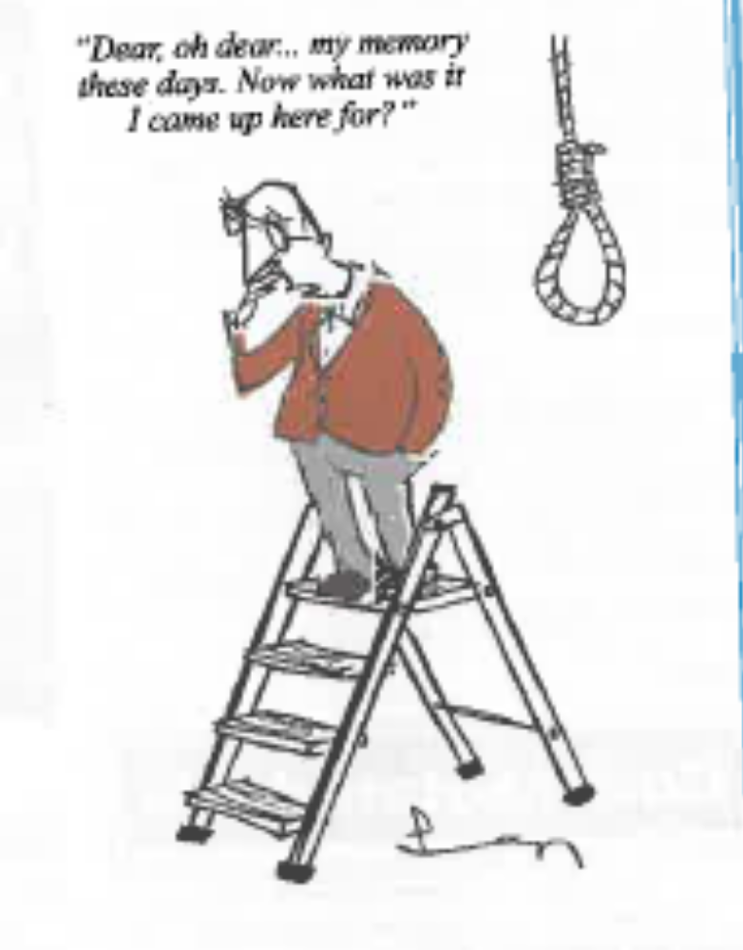
Recall Memory Problems
Private Eye 11/7/2014)
Notes:
Semantic memory is important for retrieval
Retrieval. Going to a room only to forget why you had gone there. Go back and there will be a cue to remind you of the reason for your trip
We often need a cue to recall things

Slide 13
Think of Evidence
Do we forget certain things
Those who work in care – what have you seen?

Slide 14
Memory Experiment
Follow the Instructions on the handout

Slide 15
What are the Results

Slide 16
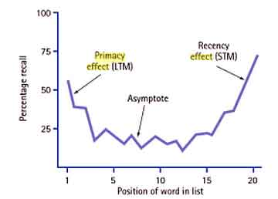
What are the implications?
Notes:
Primacy and recency effect may come up here

Slide 17
Short-Term Memory
We will now do a little experiment looking at short-term memory.
The hypothesis is that people will remember 7± 2 chunks of information, in this case single numbers (Miller 1956)
What are Chunks?
Notes:
Lets look at chunking
Can you remember the following letter sequence?
ITVAABTBBCBA
Can you now remember ITV AA BT BBC BA
A useful example is the new number used for reverse charging phone calls. BT use the tagline 0800 reverse to represent 0800 738 3773 Only two chunks.
19 year old tv joke here
Can you think of other things.
The Jeeves website is ask.com
British gas is house.co.uk
So chunks can vary in size, but are considered one lump of information. If I want to remember a phone number in Gloucester the dialling code may be remembered as one chunk 01452, and the rest of the number as separate numbers or in the case of the college 53000 just as Gloucester 53 and 3 zeros

Slide 18
Two Stage Memory
Atkinson, Shiffrin Model (1968, 1971)
Rehearsal
Short-Term
Memory
Long-Term
Memory
Retrieval
Incoming information
Transfer
Decay
Notes:
Atkinson and Shiffrin hypothesised that there is a two stage model for memory. (some textbooks include sensory memory and call it a three stage model)
Incoming information from the sensory memory is placed in a short term memory loop. The capacity for this is very chunks of information limited (Plus or minus 2).
This is held in the short-term memory and lost if it is not rehearsed or transferred to the long term memory.
Te long-term memory is assumed to have a fairly infinite capacity

Slide 19
Short-term Memory
Last fewer than 30 seconds
If material is not transferred to LTM it is lost
Very limited capacity
Subject to interference

Slide 20
Long-Term Memory
Cue Dependency
This is where memories can be linked
Been to a place before as a child?
Can you think of others?
Can you think of practical applications of this phenomenon?
Notes:
Practical applications are to make sure where you do revision is like the exam room

Slide 21
State Dependent Recall
Can remember things when in a certain mood
Remember a night out only when drunk again?
Can you think of practical applications of this phenomenon?
Notes:
Revise under time pressure – feels like exam

Slide 22
Episodic or Flashbulb Memory
Do we remember things related to important life events – first kiss?
What about Princess Diana or 9/11, what were you doing.
What do you remember about the film Bambi
Notes:
Episodic - biography

Slide 23
Memory Loss
Physical Causes
Brain injury
Alzheimer's Disease
Alcoholism
Drug use

